Slide 1
Predicting New Zealand kiwifruit yield from weather data
Peking University HSBC Business School Topics in Quantitative Finance: Machine Learning | 2017
Project Proposal | Henry Kyle | 1601213550

Slide 2

Background
New Zealand supplies 30% of the global kiwifruit market. This is worth NZD$1.4 billion annually
New Zealand sells its kiwifruit commercially via a monopsony called Zespri

Slide 3
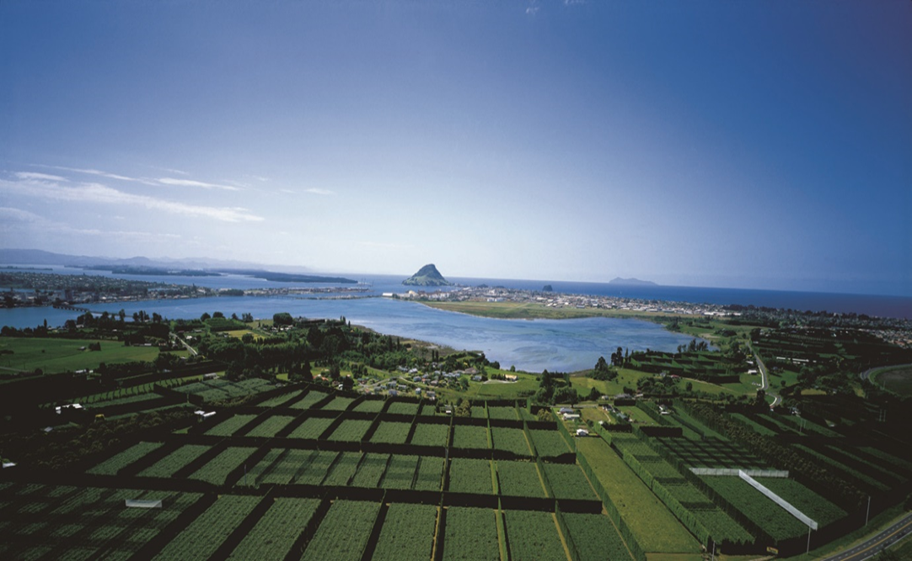
Kiwifruit orchards in the Bay of Plenty, New Zealand

Slide 4
Project Aim
To predict annual trays of kiwifruit in New Zealand per hectare of orchards using local weather data

Slide 5
Method
Apply machine learning algorithms to attempt to see the effect of weather on yield.
Will need to apply machine learning techniques aimed at continuous target variables e.g. Gradient Descent and RANSAC.
Selection of important variables will be key to producing a successful model.
In particular I will be making use of Python and some of its data analysis & machine learning packages including Pandas, Numpy and Scikit-learn

Slide 6
Data Sources
Zespri has data on their trays of kiwifruit/hectare in their annual reports stretching back 20 years
The National Institute of Water and Atmospheric Research has historical weather data including monthly mean/min/max temperatures, rainfall, sunshine hours, days of ground frost, relative humidity etc.
KVH has data on regional distribution of kiwifruit orchards
This data will need to be scraped manually. Weightings on regions will need to be given based on proportion of kiwifruit crop

Slide 7
Some initial thoughts
Potential Uses (if a good model is created)
Assist firms such as Zespri predict yield. Could potentially be combined with weather forecasting to forecast yield.
Predict the effect of global warming on kiwifruit yield
Could be applied to other crops
Potential Problems
Over time there is likely improvements in yield due to improved technology / breeding / knowledge etc. In fact Zespri annual reports suggest this has been happening recently for some kiwifruit varieties. This is difficult to quantify. Perhaps include y lag(s) as an independent variable(s)?
There is a disease spreading through kiwifruit worldwide which does have an effect on yields. Perhaps some way of accounting for this could be integrated into the model

